Slide 1
430.211 Programming Methodology (프로그래밍 방법론)
Taesup Moon
Department of Electrical and Computer Engineering
Seoul National University

Slide 2
Outline
Chapter 6: Structures and Classes
Structures
Classes

Slide 3
Outline
Chapter 6: Structures and Classes
Structures
Classes

Slide 4
Ch 6. Structures and Classes Learning Objectives
Structures
Structure types
Structures as function arguments
Initializing structures
Classes
Defining, member functions
Public and private members
Encapsulation, principles of OOP
Accessor and mutator functions
Structures vs. classes

Slide 5
Structures
2nd aggregate data type: struct
Recall: aggregate meaning "grouping"
Recall array: collection of values of same type
Structure: collection of values of different types
Treated as a single item, like arrays
Major difference: Must first "define" struct
Prior to declaring any variables

Slide 6
Structure Types
Define struct globally (typically)
a "placeholder" for what our struct will "look like"
Definition: struct CDAccountV1 ← Name of new struct "type" { double balance; ← double interestRate; ← member names int term; ← };

Slide 7
Declare Structure Variable
With the new structure type defined, now we can declare variables of this new type:
CDAccountV1 account;
Just like declaring simple types
Variable account is now of type CDAccountV1 → A struct value contains a collection of smaller values called "member values"

Slide 8


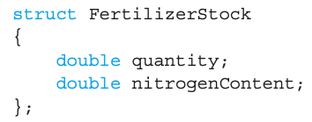
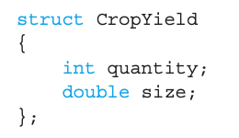
Accessing Structure Members
Dot Operator (.) to access members
Called "member variables"
The "parts" of the structure variable
Different structs can have same name member variables
No conflicts
superGrow.quantity
apples.quantity
→ No ambiguity!

Slide 9

Structure Assignments
Given structure named CropYield
Declare two structure variables: CropYield apples, oranges;
Both are variables of "struct type CropYield"
Simple assignments are legal: apples = oranges;
Simply copies each member variable of oranges into member variables of apples

Slide 10
Structures as Function Arguments
Passed like any simple data type
Call-by-value
Call-by-reference
Or combination
Can also be returned by a function
Return-type is structure type
Return statement in function definition sends structure variable back to caller

Slide 11
Structures as Function Arguments : Example
Ex)
CDAccountV1 doubleInterest(CDAccountV1 oldAccount) { CDAccountV1 temp; temp = oldAccount; temp.interestRate = 2*oldAccount.interestRate; return temp; }
In a main function:
CDAccountV1 yourAccount; yourAccount = doubleInterest(myAccount);

Slide 12
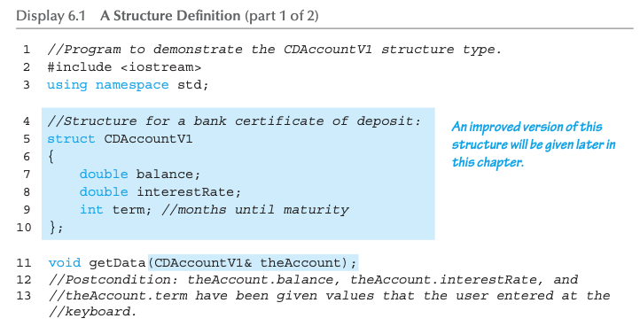
Structure Example: Display 6.1 A Structure Definition (1 of 3)

Slide 13
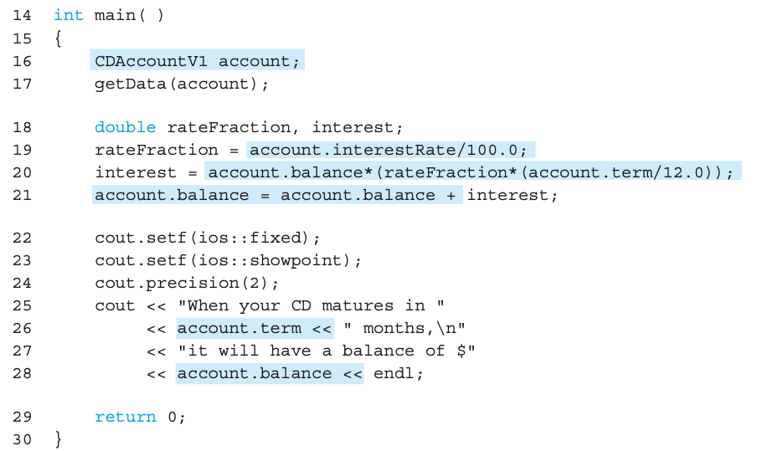
Structure Example: Display 6.1 A Structure Definition (2 of 3)

Slide 14
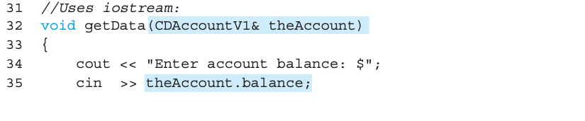
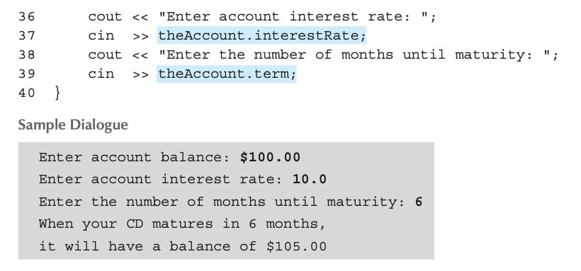
Structure Example: Display 6.1 A Structure Definition (3 of 3)

Slide 15
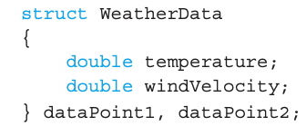
Structure Pitfall
Semicolon after structure definition
; MUST exist: struct WeatherData { double temperature; double windVelocity; }; ← REQUIRED semicolon!
Required since you "can" declare structure variables in this location

Slide 16
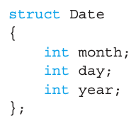
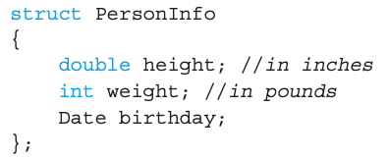


Hierarchical structures
This itself is a structure!
Read from the left to the right!
Sometimes, we can have structures whose members are themselves smaller structures

Slide 17
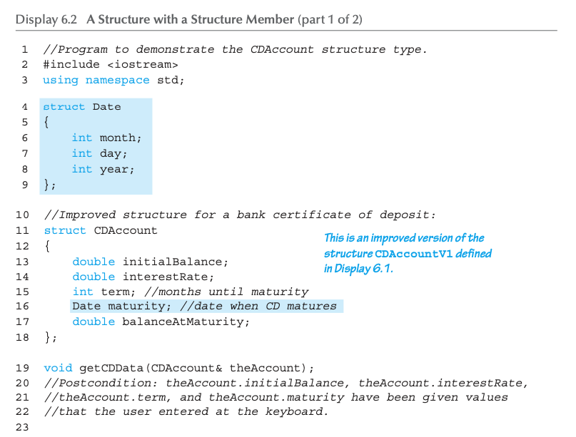
Hierarchical structures : Example (1/3)

Slide 18
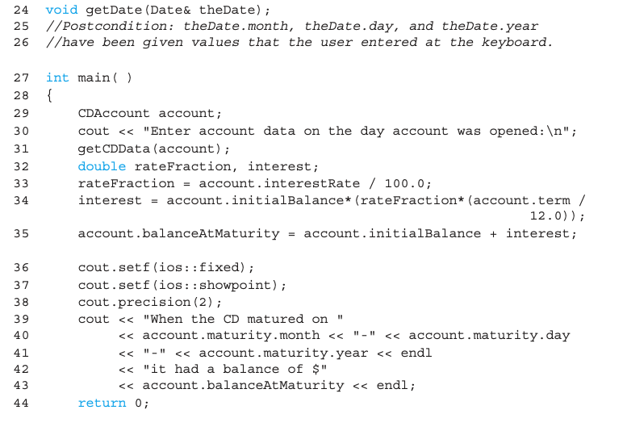
Hierarchical structures : Example (2/3)

Slide 19
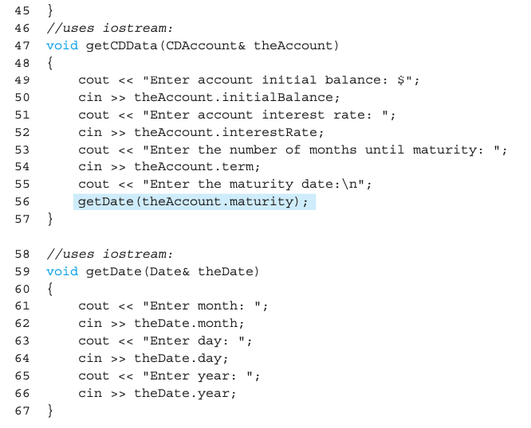
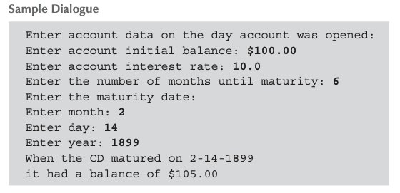
Hierarchical structures : Example (3/3)

Slide 20
Initializing Structures
Can initialize at declaration
Ex: struct Date { int month; int day; }; Date dueDate = {12, 31};
Declaration provides initial data to all two member variables
Error if there are more initializer values than struct members
If fewer than struct members, values are used to initialize data members in order → Data member without an initializer is initialized to a zero value of an appropriate type for the variable)

Slide 21
Outline
Chapter 6: Structures and Classes
Structures
Classes

Slide 22


Class
Similar to a structure type
But, we can also add member FUNCTIONS
Integral to object-oriented programming (OOP)
Objects
The value of a variable of a class type
Contains both data and function members
Class defines what the object should be.
Each instance of that class is called an object.

Slide 23
Class Definitions
Defined similarly as structures
Example: class DayOfYear ← name of a new class type { public: ← On “public” vs. “private” given later void output(); ← member function declaration! int month; int day; };
Notice that only the member function’s prototype is included
Function’s definition is somewhere else

Slide 24
Declaring Objects
Declared the same as other variables
Predefined types, structure types
Example: DayOfYear today, birthday;
Declares two objects of class type DayOfYear
Objects include:
Data
Ex) month, day
Operations (i.e., member functions)
Ex) output()

Slide 25
Class Member Access
Dot operator
Members are accessed the same as structures!
Ex)
To access the member variables: today.month today.day
To access the member function: today.output(); ← Invokes the member function

Slide 26
Class Member Functions
Must define or "implement" class member functions
Like other function definitions
Can be after main()
Must specify class: void DayOfYear::output() {…}
:: is called the scope resolution operator (what is the difference with the dot operator?)
Instructs compiler "what class" member is from (more than one class may have the member function with the same name!)
Item before :: is called type qualifier

Slide 27
Class Member Functions Definition
Notice output() member function’s definition (in the next example)
When it refers to member data of the class
No need to use the dot operator!
The function will refer to "that object’s" data when invoked
Example: today.output();
Displays "today" object’s data

Slide 28
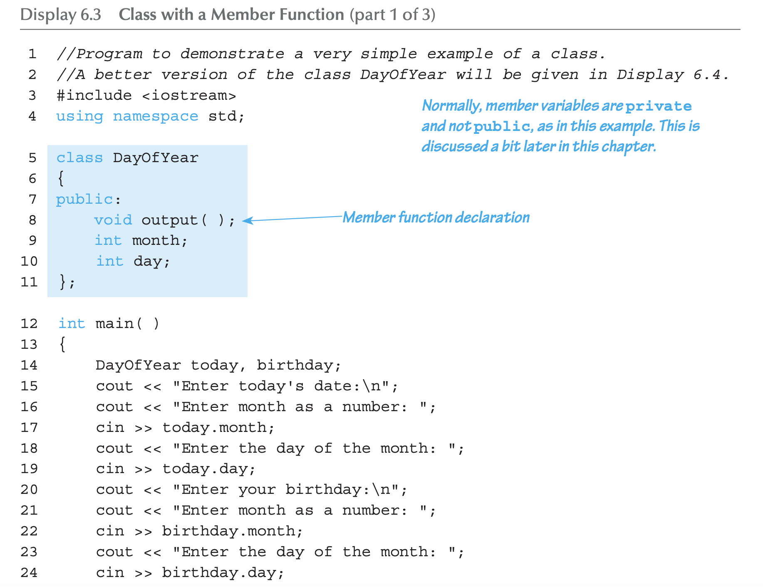
Complete Class Example: Display 6.3 Class With a Member Function (1 of 3)

Slide 29
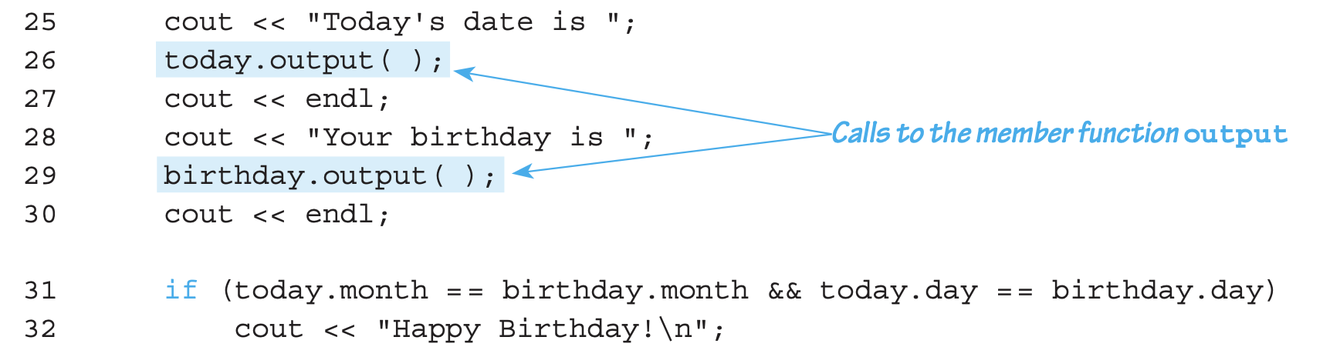
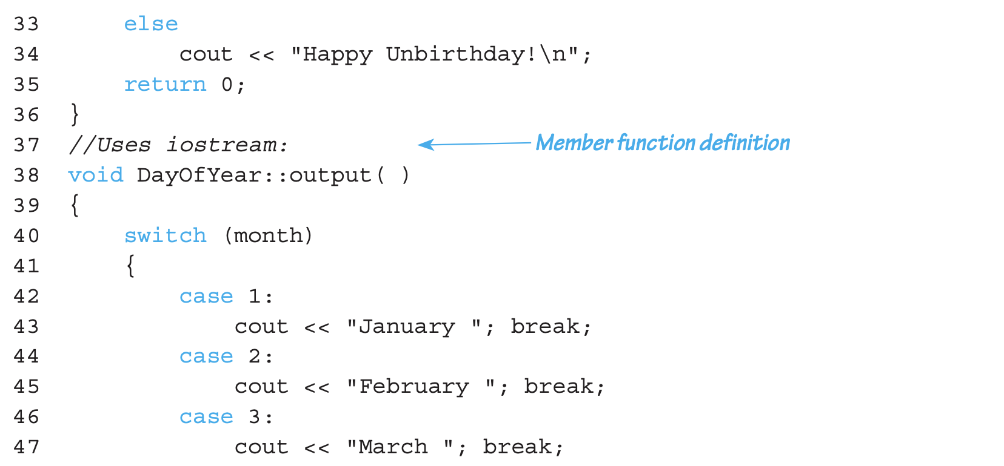
Complete Class Example: Display 6.3 Class With a Member Function (2 of 3)

Slide 30
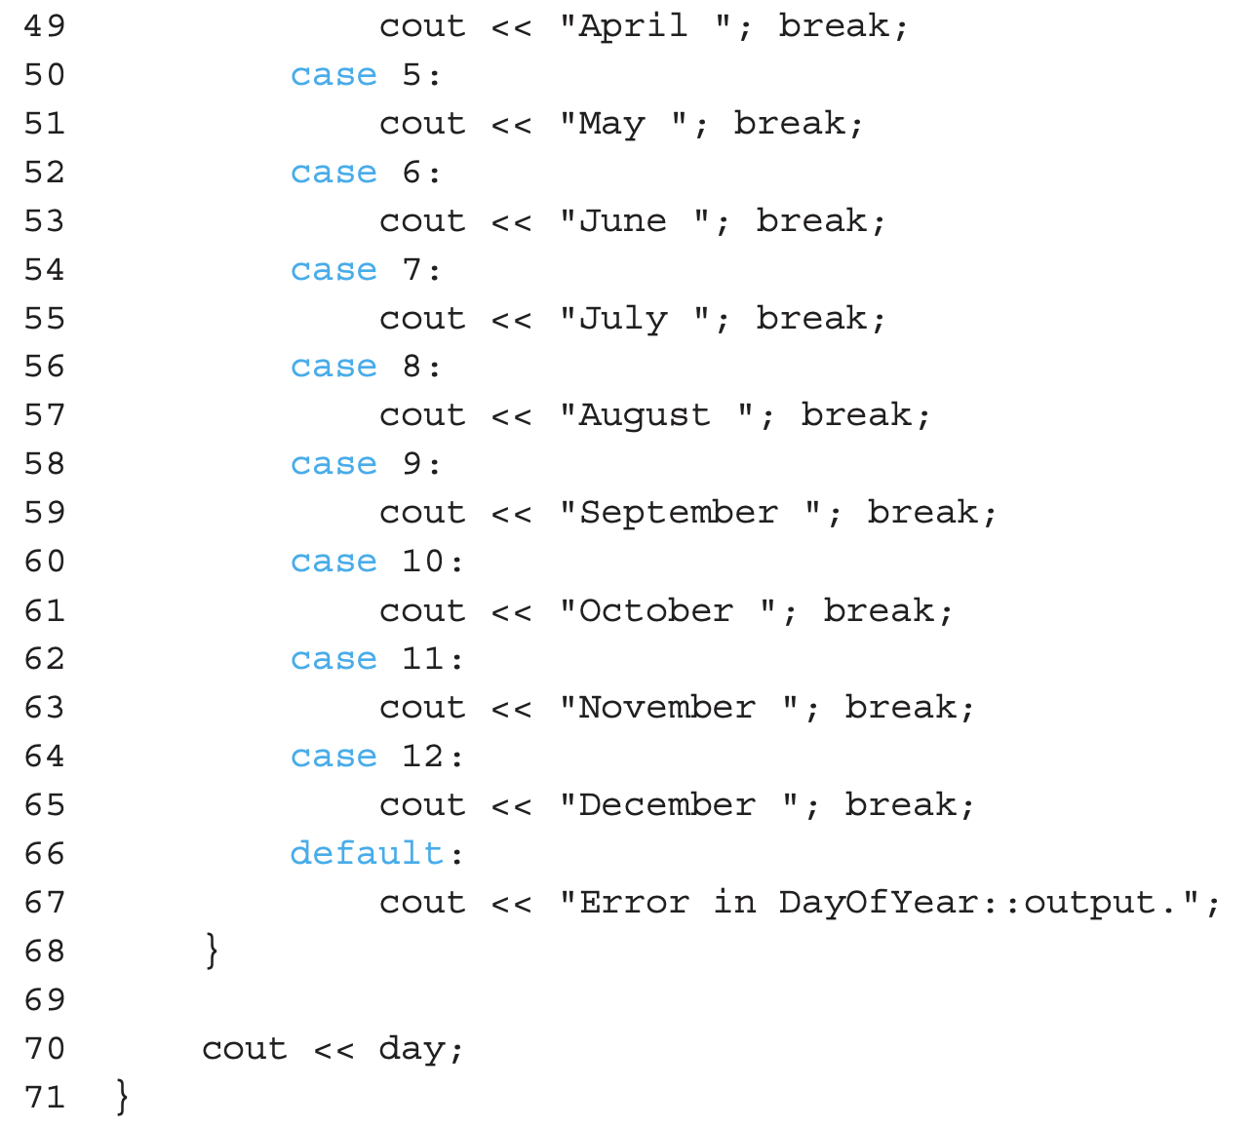
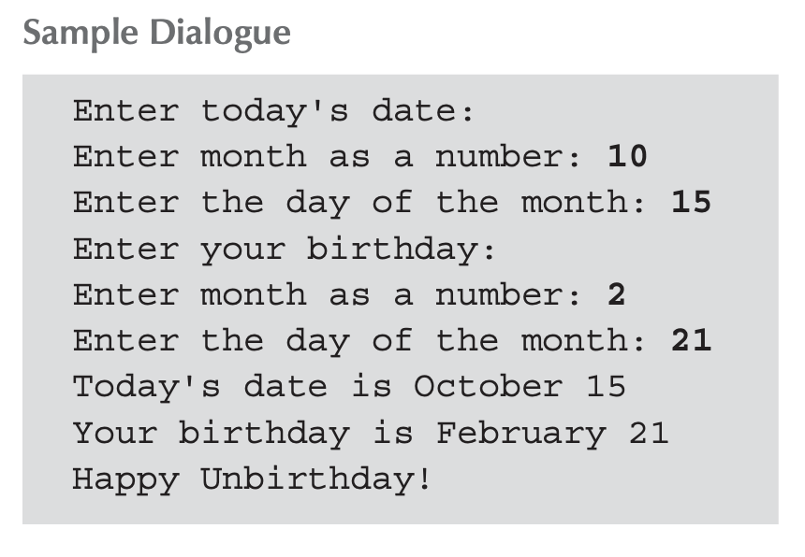
Complete Class Example: Display 6.3 Class With a Member Function (3 of 3)

Slide 31
A Class’s Place
Class is a full-fledged type!
Just like usual data types int, double, etc.
Can have variables of a class type
We simply call them "objects"
Can have parameters of a class type
Call-by-value
Call-by-reference
Can use class type like any other type!

Slide 32
Encapsulation
Not that any data type includes
Data (range of data)
Operations (or functions that can be performed on data)
Ex) int has: Data: -2147483648 to 2147483647 (for 32 bit int) Operations: +,-,*,/,%,logical, etc.
Two points
Data type is not just a simple collection of values (operation is needed!)
We do not need to know how the int data type is implemented! (But, we can just use it!)

Slide 33
Abstract Data Types (ADT)
A data type
Collection of data values + set of operations for the values
Programmers don’t need to know the details on how the values and operations are implemented → “Abstract”!!
int is an ADT
Classes
Programmer-defined ADTs
WE specify data, and the operations on our data!
Details of how the “operations” are implemented should be hidden from the users → declaration/comments should suffice for using the class
Encapsulation/Information hiding/data abstraction

Slide 34

Encapsulation – Separation of Interface & Implementation
How do we realize encapsulation in C++?
Data and function access is encouraged to be done only through the (public) member functions (interface)
Hide the implementation details of the data and functions (private!)
Interface
The users of a class need to know only its interface. → Only need to know what the class does rather than how the class is implemented!
Implementation
An important feature of OOP!

Slide 35
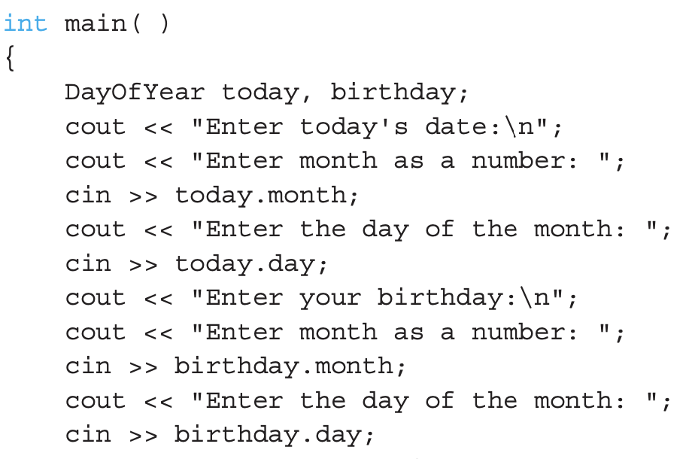
Public and Private Members
In Display 6.3, you need to know the class has two ints
Violates encapsulation!
No need to know whether a month is stored as a number or a string
We can utilize public/private members
Public:
“user-accessible”
Usually member functions
Private:
Not directly accessible to users
Allow manipulation only via member functions!

Slide 36
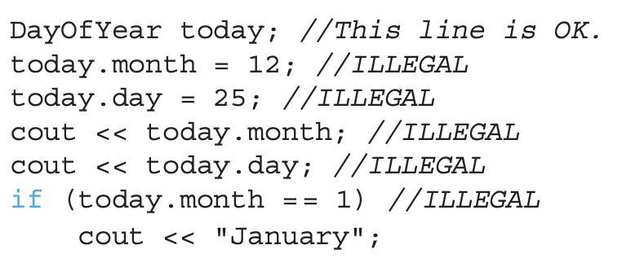
Public and Private Example
Modify previous example: class DayOfYear { public: void input(); void output(); private: int month; int day; };
Data is now private
Must now call public member functions to access today.input(), today.output()

Slide 37
Why Encapsulation?
Example (Box class)
Box : (1, 2, 3)
Area : 22
Volume : 6
Box : (30, 30, 30)
Area : 22
Volume : 6
class Box {
public:
Box() : height(0), width(0), length(0), area(0), volume(0){}
void set(double h, double w, double l) {
height = h; width = w; length = l;
area = 2 * (h*w + w*l + l*h);
volume = h*w*l;
}
void print() {
cout << "Box : (" << height << ", " << width << ", " << length << ")" << endl;
cout << "Area : " << area << endl;
cout << "Volume : " << volume << endl;
}
double height, width, length;
double area, volume;
};
void main() {
Box box1;
box1.set(1,2,3);
box1.print();
box1.height = box1.width = box1.length = 30; // ruins data consistency
box1.print();
}

Slide 38
Prevent the Danger of Unintended Change
Example (Box class)
Box : (1, 2, 3)
Area : 22
Volume : 6
Box : (30, 30, 30)
Area : 5400
Volume : 27000
class Box {
public:
Box() : height(0), width(0), length(0), area(0), volume(0){}
void set(double h, double w, double l) {
height = h; width = w; length = l;
area = 2 * (h*w + w*l + l*h);
volume = h*w*l;
}
void print() {
cout << "Box : (" << height << ", " << width << ", " << length << ")" << endl;
cout << "Area : " << area << endl;
cout << "Volume : " << volume << endl;
}
double height, width, length;
double area, volume;
};
void main() {
Box box1;
box1.set(1,2,3);
box1.print();
box1.set(30,30,30); // data are now consistent
box1.print();
}

Slide 39
Enforcing Encapsulation : Data as Private Members
Example (Box class)
Box : (1, 2, 3)
Area : 22
Volume : 6
Box : (30, 30, 30)
Area : 5400
Volume : 27000
class Box {
public:
Box() : height(0), width(0), length(0), area(0), volume(0){}
void set(double h, double w, double l) {
height = h; width = w; length = l;
area = 2 * (h*w + w*l + l*h);
volume = h*w*l;
}
void print() {
cout << "Box : (" << height << ", " << width << ", " << length << ")" << endl;
cout << "Area : " << area << endl;
cout << "Volume : " << volume << endl;
}
private:
double height, width, length;
double area, volume;
};
void main() {
Box box1;
box1.set(1,2,3);
box1.print();
box1.set(30,30,30); // box1.height=box1.width=box1.length=30; produces an error
box1.print();
}
cannot access directly in main() function

Slide 40
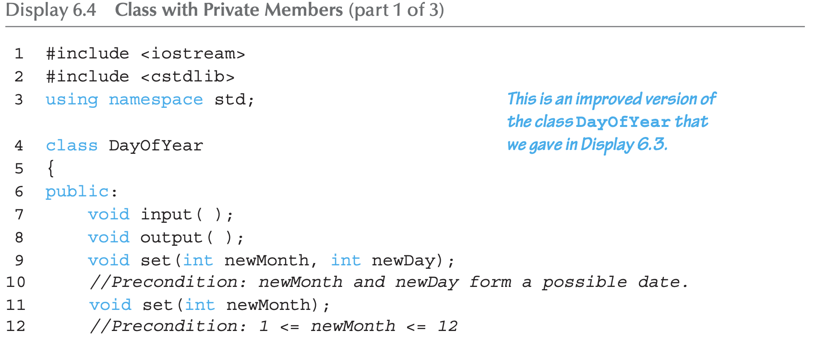
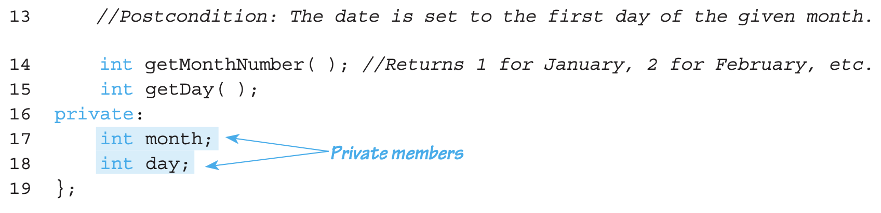
Class with Private Members Example : Display 6.4 (1/4)

Slide 41
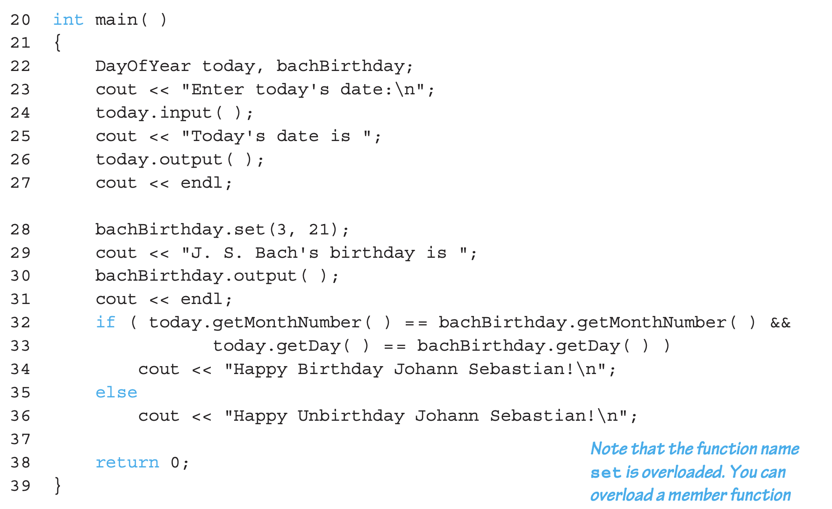
Class with Private Members Example : Display 6.4 (2/4)

Slide 42
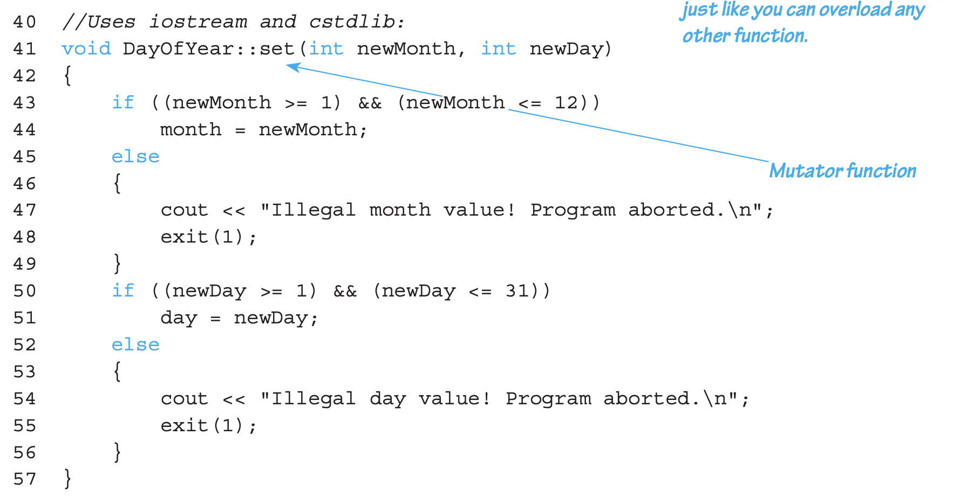
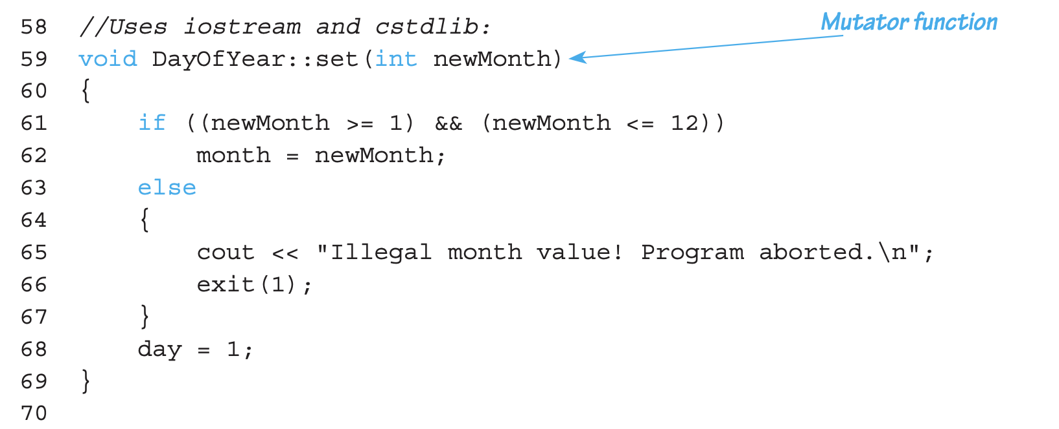
Class with Private Members Example : Display 6.4 (3/4)

Slide 43
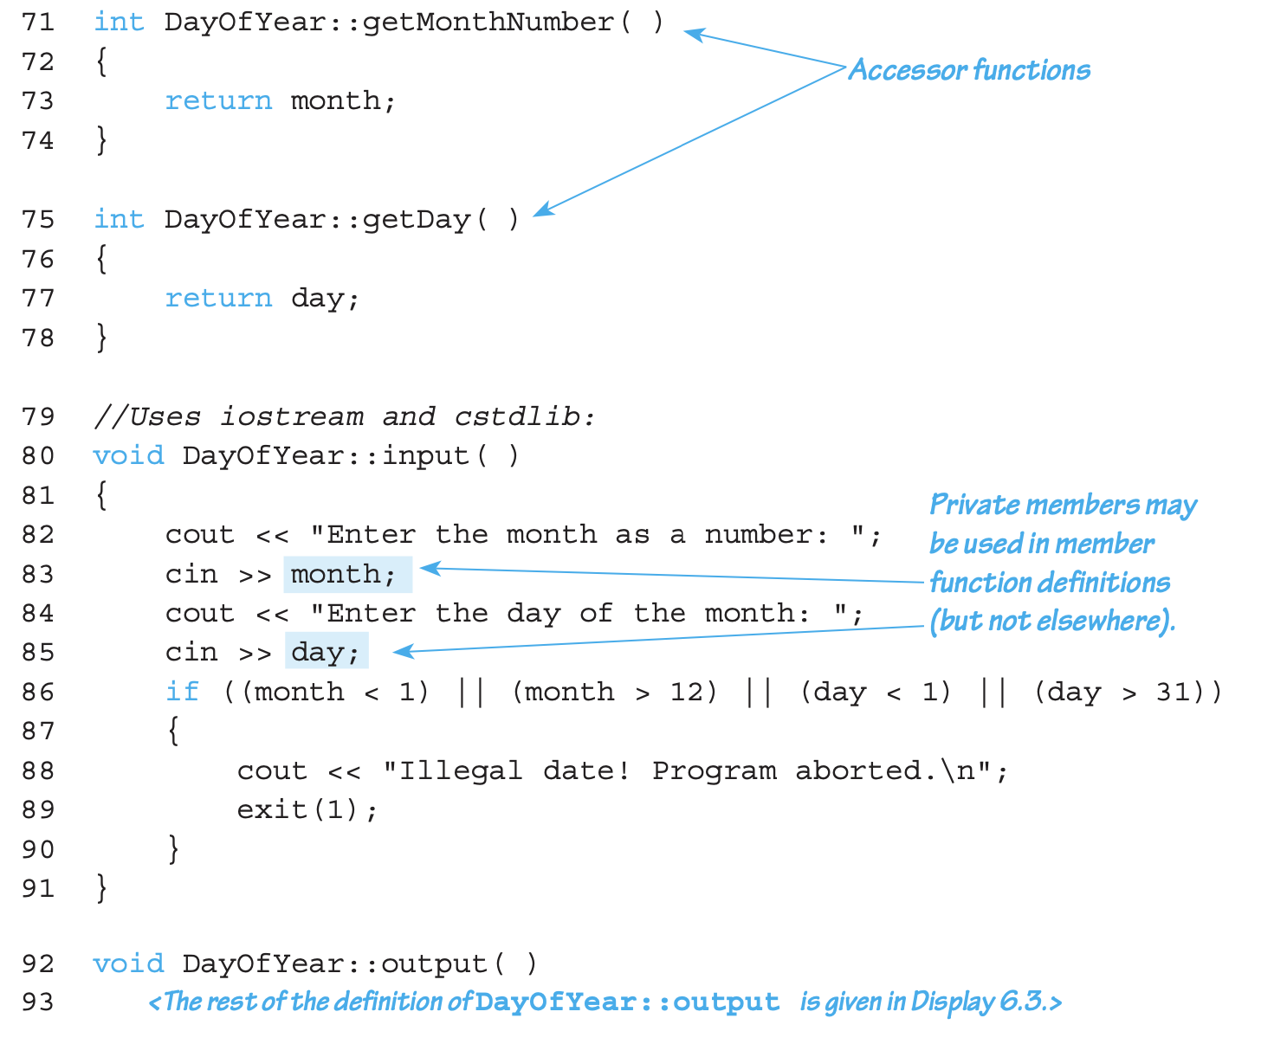
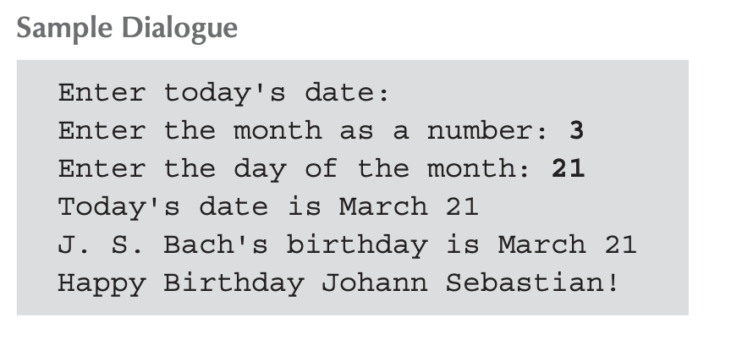
Class with Private Members Example : Display 6.4 (4/4)

Slide 44
Public and Private Style
Can place public & private in any order
In fact, public, private, and then public again is possible
But, commonly have one public and one private section
More typically place public first
Allows easy viewing of portions that can be USED by programmers using the class
Private data is "hidden", so irrelevant to users

Slide 45
Accessor and Mutator Functions
Object may need to "do something" with its private data
Call accessor member functions
Allow object to read data
Also called "get member functions"
Simple retrieval of member data
Mutator member functions
Allow object to change data
Also called ”set member functions"
Manipulated based on application

Slide 46
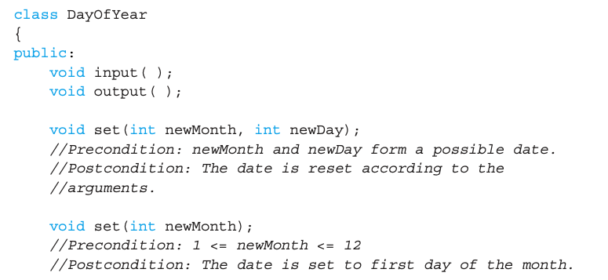
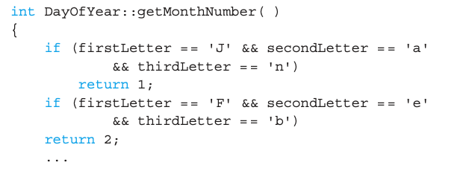
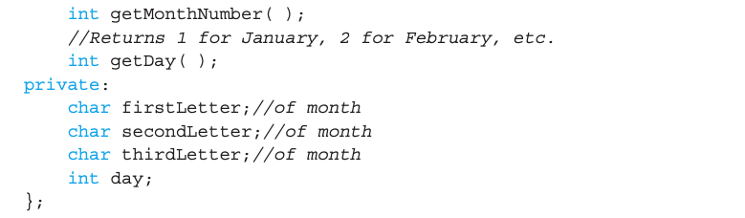
A Test for Encapsulation
A different class definition will do the same job
The detail on how the data is stored is NOT important for a user!
Exactly the same accessors and mutators!
Note the different private variables!

Slide 47
Thinking Objects
Focus for programming changes
Before → algorithms take the center stage
OOP → data is the focus
Algorithms are still important
They simply focus on their data
Are "made" to "fit" the data
Designing software solution
Define variety of objects and define how they interact

Slide 48
Structure vs. Class
In fact, Class in C++ is an extension of Structure in C
Structures
Normally used with all member variables public & no member functions
However, in C++, structure can also have public/private variables/functions
Still encouraged to use structure as before
One clear difference
For Structure, default is public, and for Class, default is private

Slide 49
Summary 1
Structure is collection of different types
Class used to combine data and functions into single unit → object
Class and structure types can be formal parameters to functions
Member variables and member functions
Can be public → accessed outside class
Can be private → accessed only in a member function’s definition

Slide 50
Summary 2
Encapsulation is the key for OOP
Separate interface and implementation!
Build your own ADT with classes!
Using private members can realize the encapsulation

Slide 51
Thank you!
Web: http://mindlab-snu.github.io
E-mail: tsmoon@snu.ac.kr

